Slide 1
LocalStorage

Slide 2
Client-Side Browser Storage
Cookies are shared by clients and servers, and are fairly small (4kb)
There are Storage technologies built-in to the browser to store data that doesn't need to be stored on the server
What information can you think of that is useful to store only on the client?
Color theme preferences
Saved shopping cart (until an "order" button is clicked to submit a request
Previous searches
...

Slide 3
Browser storage technologies
localStorage and sessionStorage can be used to store data on the browser.
localStorage is a window property that allows you to save information across browser sessions (i.e after you close the browser)
sessionStorage is a window property that allows you to save information for this session only, and will be cleared when the page is closed.
Name/value pairs (seen in cookies and Storage) are supported by most every browser

Slide 4
Storage
There are four useful methods for Storage.
method | description
setItem(keyName, keyValue) | Sets the keyName location in storage to be keyValue
getItem(keyName) | Retrieves the keyValue in storage associated with keyName
removeItem(keyName) | Removes the keyName location in storage
clear() | Removes all key/values in the storage
storage-demo.html compares the two storage technologies using the code on the following slides. Inspect the Chrome Application Tab to see the difference between different browser windows.

Slide 5
localStorage example
window.localStorage.setItem("color-mode", "dark");
window.localStorage.setItem("language", "en");
window.localStorage.setItem("favorite-drink", "coffee");
let colorMode = window.localStorage.getItem("color-mode");
window.localStorage.removeItem("color-mode");

Slide 6
sessionStorage example
window.sessionStorage.setItem("color-mode", "dark");
window.sessionStorage.setItem("language", "en");
window.sessionStorage.setItem("favorite-drink", "coffee");
let colorMode = window.sessionStorage.getItem("color-mode");
window.sessionStorage.removeItem("color-mode");

Slide 7
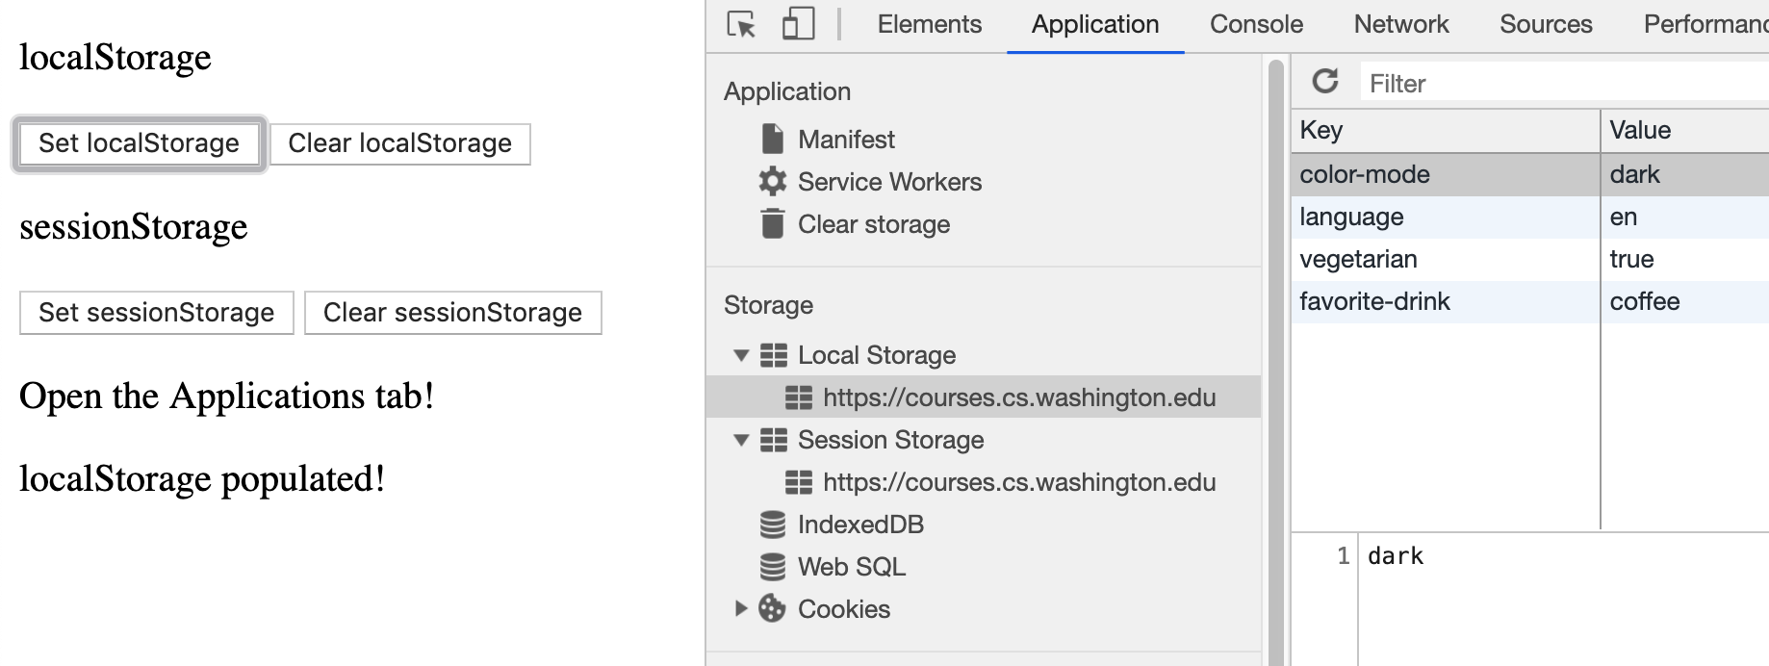
Viewing Storage in the Applications Tab

Slide 8
Requirement: Values are Strings
But what if you want a key to hold a collection of items (e.g. a dictionary of preferences, or a current cart)?
let notes = [{ tag : "Personal", note : "Feed Orange." },
{ tag : "Personal", note : "Exercise Juice."}];
window.localStorage.setItem("notes", notes);
let data = window.localStorage.getItem("notes");
// { notes : [Object object] }
Solution: Save stringified object (possibly an array) and access as parsed JSON
window.localStorage.setItem("notes", JSON.stringify(notes));
let data = JSON.parse(window.localStorage.getItem("notes"));
// { notes : [{ tag : "Personal", note : "Feed Orange." },
// { tag : "Personal", note : "Exercise Juice." }]}

Slide 9
HTTP and State
HTTP is a stateless protocol; it simply allows a browser to request a single resource from a web server.
Once the resource has been sent to the client, the server does not keep track of any information about what was sent (other than maybe in a log file of the transaction).
But then how can websites like Amazon.com, Google, etc. remember whether you're logged in and your shopping preferences?
How does a client uniquely identify itself to a server, and how does the server provide specific content to each client?

Slide 10
Cookies
A small (max 4kb) amount of information stored within the computer browser
Introduced in 1994 for the Netscape browser to improve shopping experience
Have many uses:
Authentication, remembering login information
User tracking
Maintaining user preferences, shopping carts, etc.
Demo example of language preference cookie (try changing the language and finding the google translate cookie in your Chrome Applications tab - what happens when you refresh the page?).

Slide 11
Cookies: Shared Between Client and Server
Cookies are associated with certain websites. They consist of a key and a value. They also have an expiration date, and will go away when it is reached. If an cookie does not have an expiration date, it is usually a "session cookie", cleared when the browser is closed. (the King County's language cookie is a session cookie).
Cookies let us store information on a user's computer, for things like keeping them logged in even if they close the page. These are sent by the same client to the server in future requests (until they expire).
As a web developer, this is a great feature to have to improve user experience (but you should be clear about your Privacy Policy).

Slide 12
More Cookie Details
Cookies are only data, not program code.
Cookies can be used to track your viewing habits on a particular site.
Do you think this is a good thing? Or a bad thing?
New privacy laws in Europe (GDPR) and California (CCPA) are making website owners rethink using cookies.
A great 10-minute video here with a simple overview of how different types of cookies work

Slide 13
Format of Cookies
Cookies are essentially just key -> value pairs with some extra information.
path: which page does this apply to?
domain: the domain (usually the current one you're on)
max-age: how long (in seconds) is this cookie good for
expires: what's the expiration date for this cookie?
secure: HTTPS-only?
samesite: other domains are not allowed to eat this cookie.

Slide 14
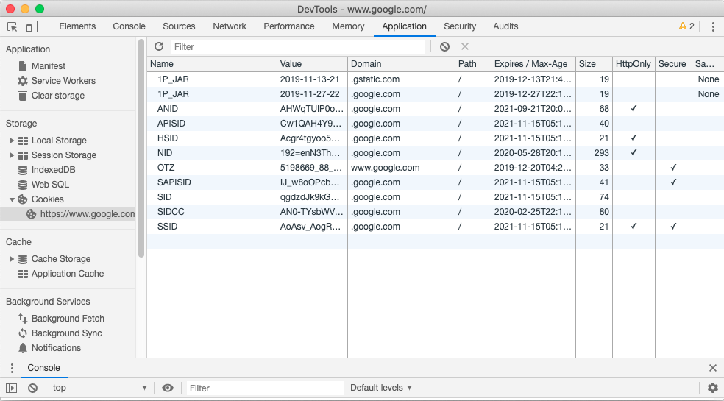
Viewing Cookies
You can view your cookies for different sites on the Chrome Tools Application Tab. Try it out on different websites!

Slide 15
How cookies can be set and retrieved
Client-Side
JavaScript can set and retrieved using document.cookie
More details here
Server-Side (Node/Express, but also other server-side languages):
When the browser requests a page, the server may send back a cookie(s) with it to store on the client - this can be done in different server-side languages.
Future requests to the server will bring back the cookie until it expires.
If your server has previously sent any cookies to the browser, the browser will send them back on subsequent requests to remind the server who is connecting to it.

Slide 16
How to read and use a cookie?
document.cookie
Returns a long string, looking something like:
"_ga=GA1.2.1860036673.1569205383; dwf_sg_task_completion=False; _gid=GA1.2.1782728754.1588304902; lux_uid=158861962030447448"
This string follows a pattern (RegEx, anyone?), like key=value; key2=value2
Can be tricky to parse correctly. So... there's another way.

Slide 17
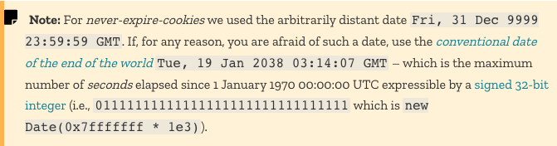
Cookie Footnote: Cookies and Expiration Time

Slide 18
Summary: Cookie vs. Browser Storage
Note that storage limits for local/session storage depend on browser and device (Desktop vs. Mobile).
 | Cookies | Local Storage | Session Storage
Size | 4kb | ~10mb | ~5-10m
Expires | Manually Set | Never | When browser is closed
Storage Location | Browser & Server | Browser Only | Browser only
Sent w/ HTTP Requests | Yes | No | No

